Slide 1
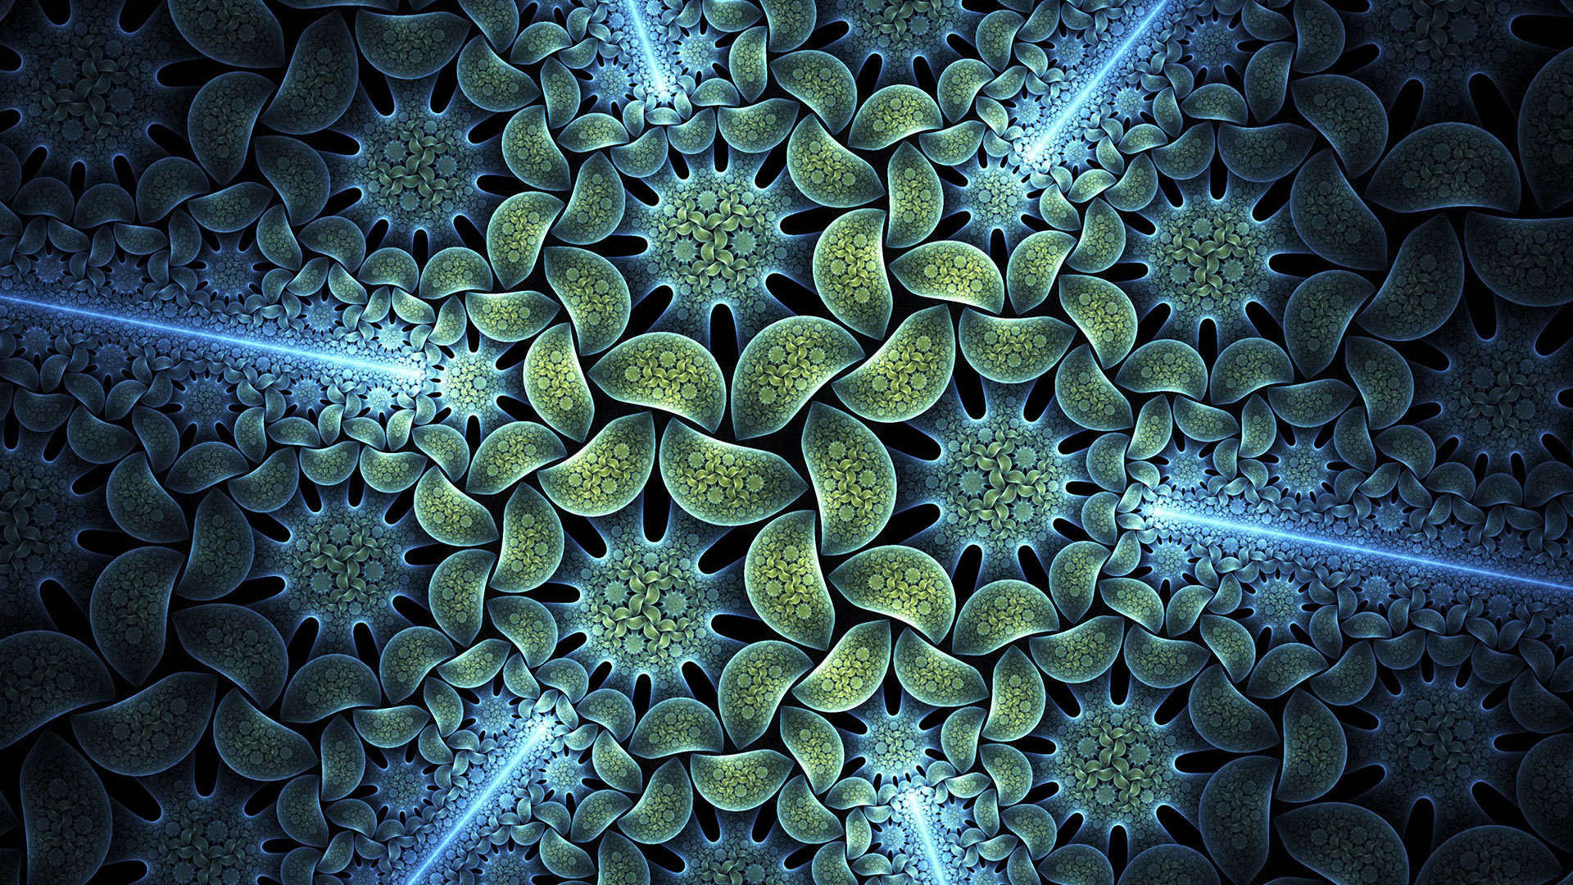
Fractals
Chris Piech
CS 106B
Lecture 7
Jan 22, 2016

Slide 2
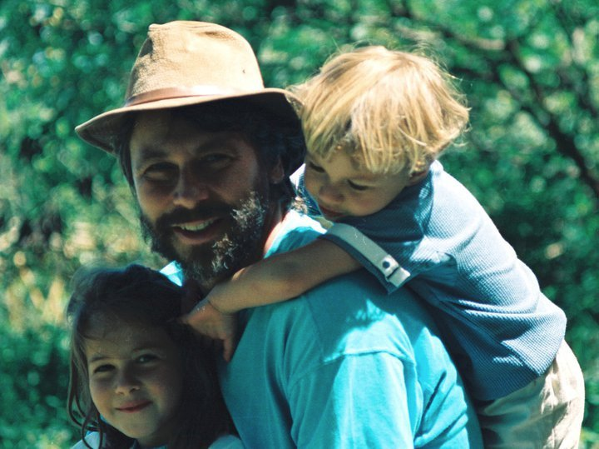
CLaIR Hours
Me
My sister, Claire
CLaIR:
Get help on concepts
Sunday , Tuesday, Thursday
8-10PM
Old Union 2nd Floor

Slide 3


Slide 4
Review

Slide 5
Recursion
Define an operation in terms of itself.

Slide 6
Three Musts of Recursion
Your code must have a case for all valid inputs.
You must have a base case (makes no recursive calls).
When you make a recursive call it should be to a simpler instance (forward progress towards base case)

Slide 7
Recursive Factorial
N! = N * (N – 1)!
Fact(N) is equal to N times Fact(N – 1)
5! = 5 * 4 * 3 * 2 * 1
5! = 5 * 4!

Slide 8

Recursive Factorial
int fact(int n) {
if(n == 0) {
// base case
return 1;
} else {
// recursive case
return n * fact(n – 1);
}
}
N! = N * (N – 1)!

Slide 9
Recursive Factorial
int fact(int n) {
if(n == 0) {
// base case
return 1;
} else {
// recursive case
return n * fact(n – 1);
}
}
N! = N * (N – 1)!

Slide 10
Recursive Factorial
int fact(int n) {
if(n == 0) {
// base case
return 1;
} else {
// recursive case
return n * fact(n – 1);
}
}
N! = N * (N – 1)!

Slide 11
Common Bug
int fact(int n) {
if(n == 0) {
// base case
return 1;
} else {
// recursive case
n * fact(n – 1);
}
}
N! = N * (N – 1)!

Slide 12
snazzy

Slide 13
Tower of Hanoi Insight
A
B
C
This disk...
...needs to get over here.

Slide 14
End Review

Slide 15

Today’s Goal
Be able to write graphical recursive functions

Slide 16
Recursion you can see

Slide 17
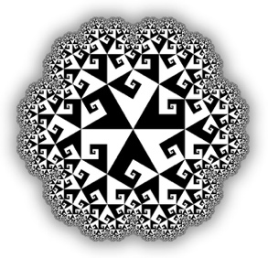
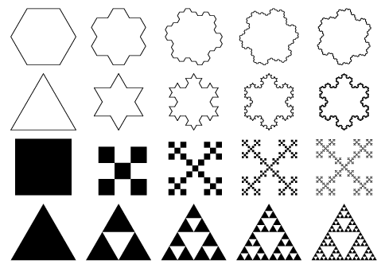
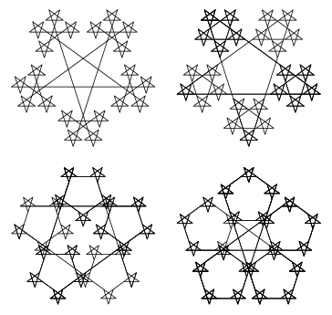
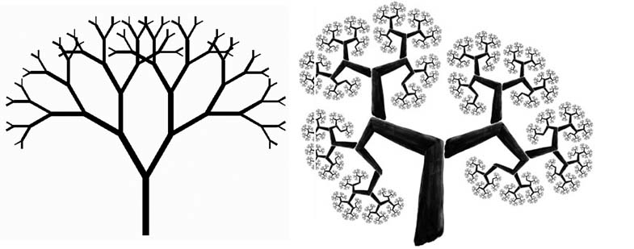
Fractals
fractal: A recurring graphical pattern. Smaller instances of the same shape or pattern occur within the pattern itself.

Slide 18
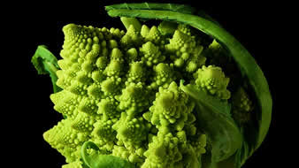
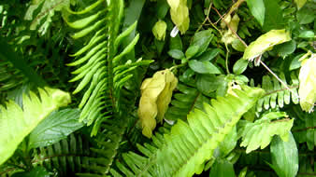
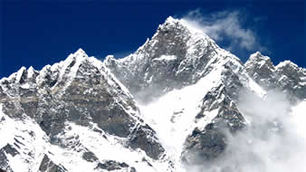
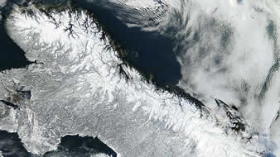
Fractals in Nature
Many natural phenomena generate
fractal patterns:
earthquake fault lines
animal color patterns
Clouds
mountain ranges
Snowflakes
Crystals
DNA
…

Slide 19
Ready?

Slide 20
Let’s go!

Slide 21
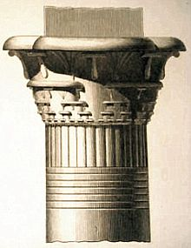
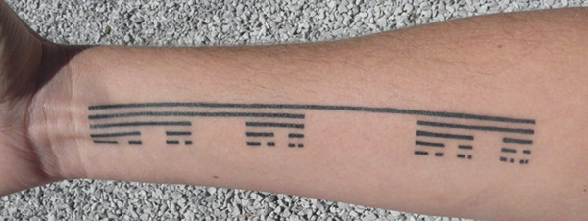
Cantor Fractal

Slide 22
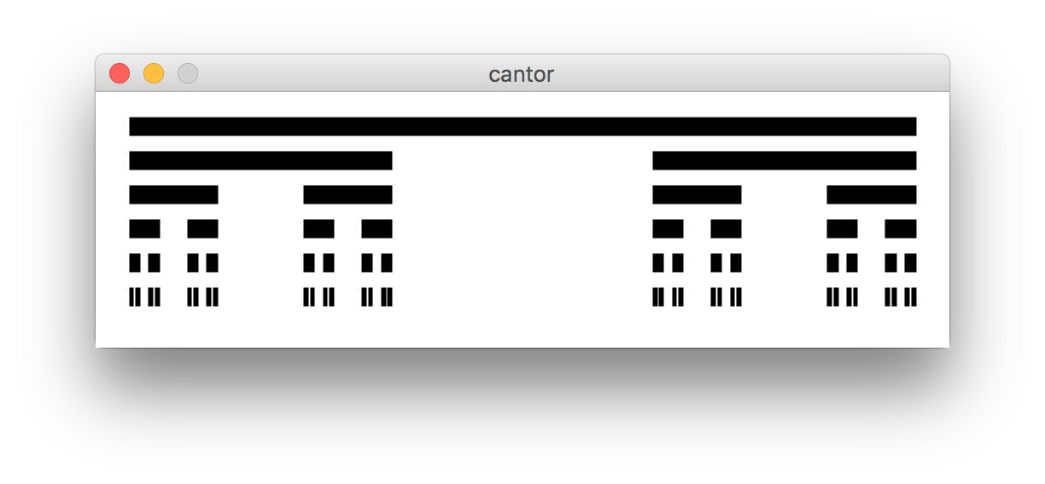
Cantor Fractal

Slide 23
Parts of a Cantor set image…
are Cantor set images

Slide 24
Cantor Fractal
Another cantor set
Also a cantor set

Slide 25
GPoint
x = 0
y = 0
GWindow w;
GPoint a(100, 100);
cout << a.getX() << endl;
GPoint a

Slide 26
GPoint
x = 0
y = 0
GPoint b
GWindow w;
GPoint a(100, 100);
GPoint b(20, 20);
cout << a.getX() << endl;
w.drawLine(a, b);
GPoint a

Slide 27
GPoint
x = 0
y = 0
GWindow w;
GPoint a(100, 100);
GPoint b(20, 20);
cout << a.getX() << endl;
w.drawLine(a, b);

Slide 28

Cantor Fractal

Slide 30
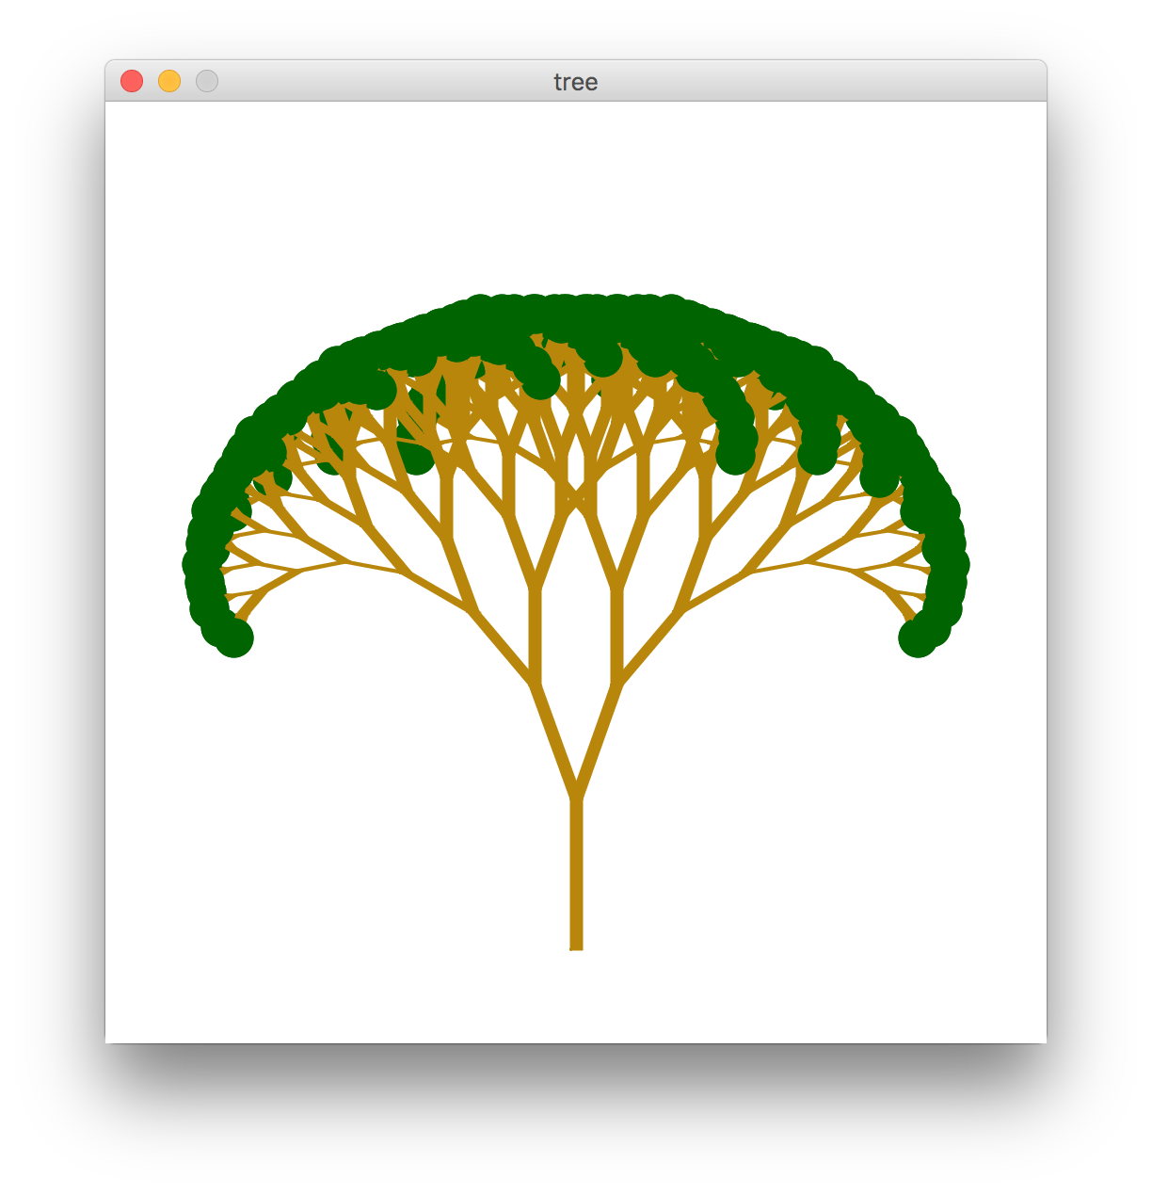
Pythagoreas Tree

Slide 31
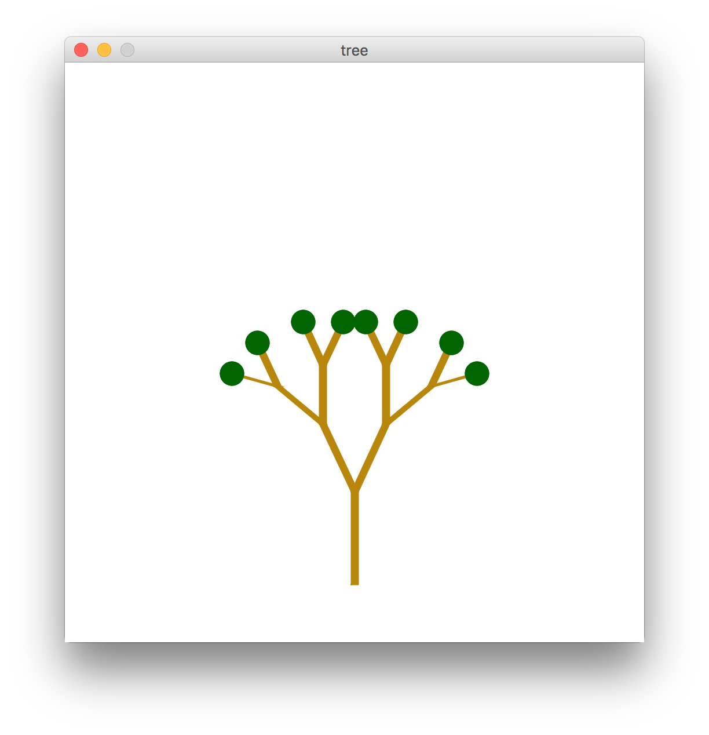
Pythagoreas Tree
Depth = 4

Slide 32
Polar Move
length
angle
point

Slide 33
Polar Move
new
point
length
angle
point

Slide 34
Polar Move
new
point
length
angle
point
movePolar(GPoint start, double length, double angle);

Slide 35
Pythagoreas Tree

Slide 36
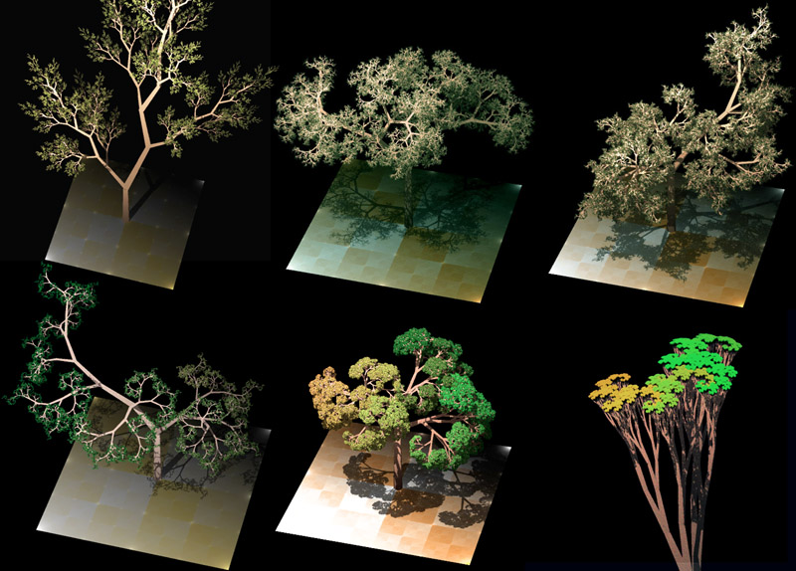
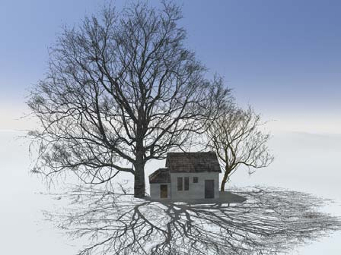
Soeren Perk, Guibas Lab, Stanford

Slide 38
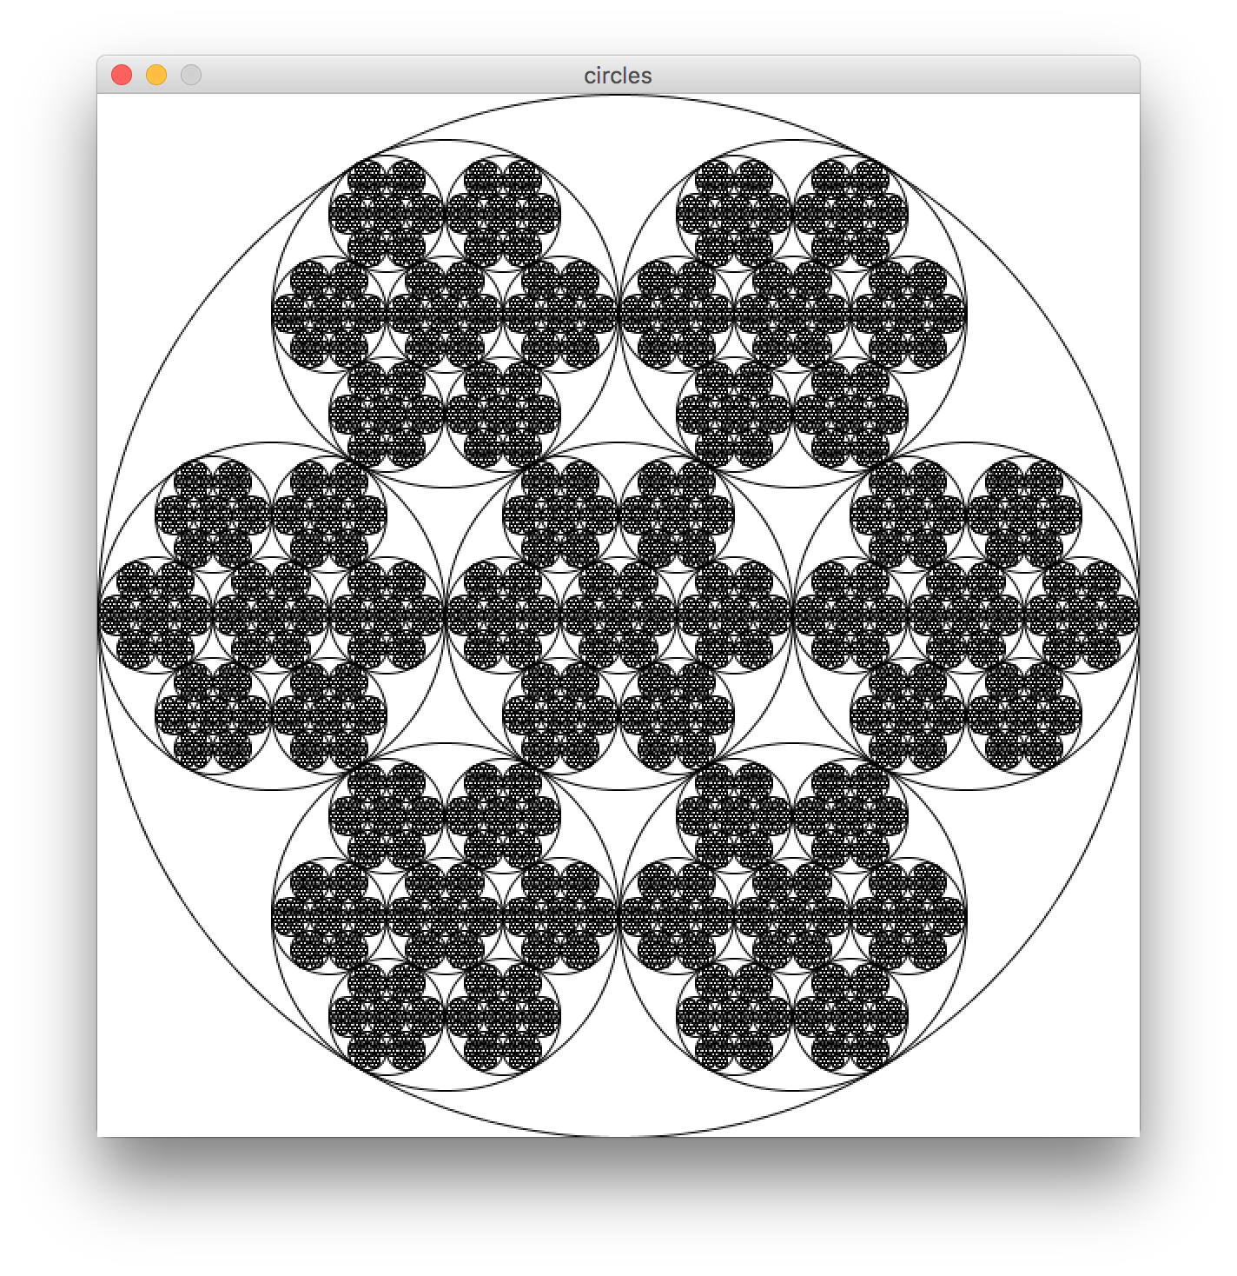
Fractal Circles

Slide 40
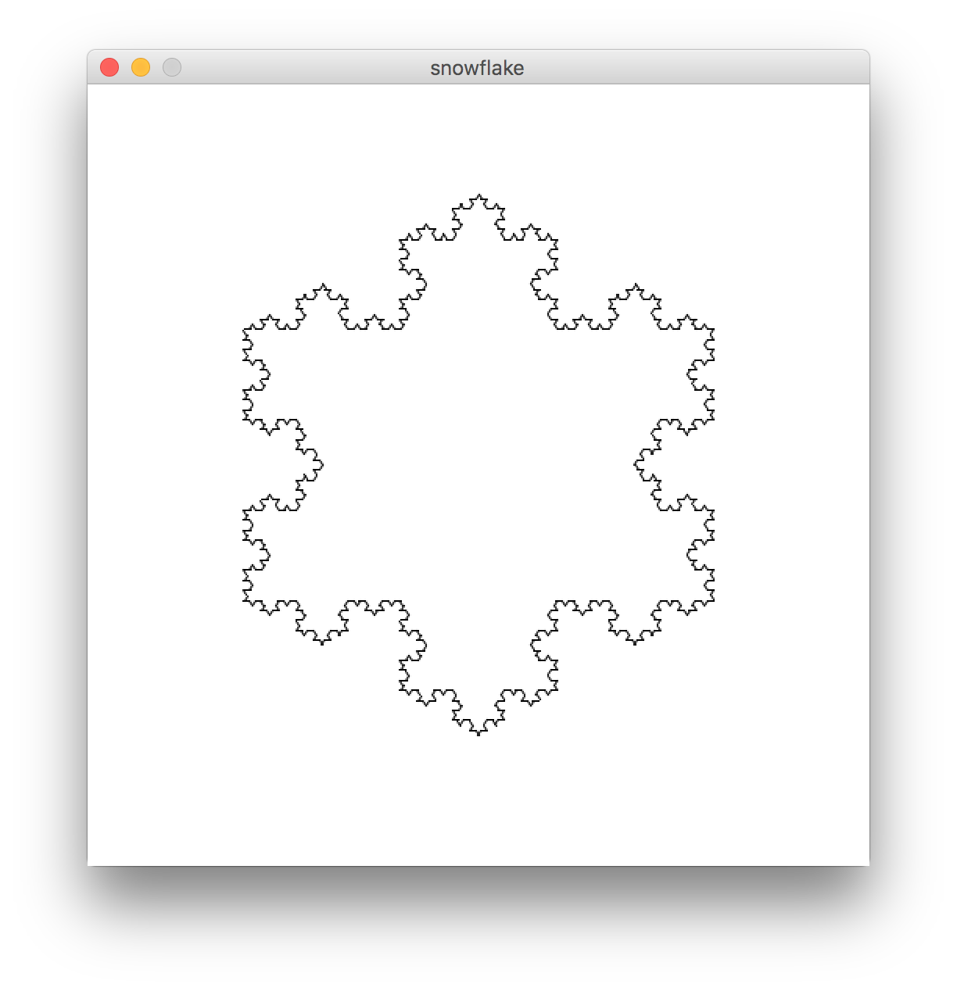
Koch Snowflake
I don’t plan to have time to solve this

Slide 42
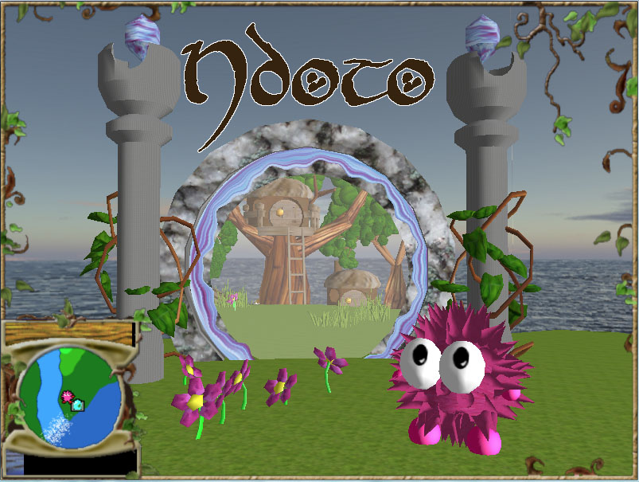
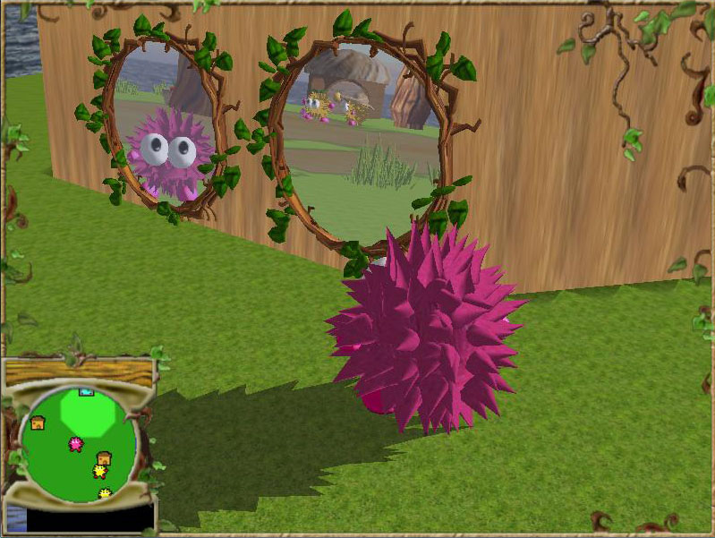

Slide 43
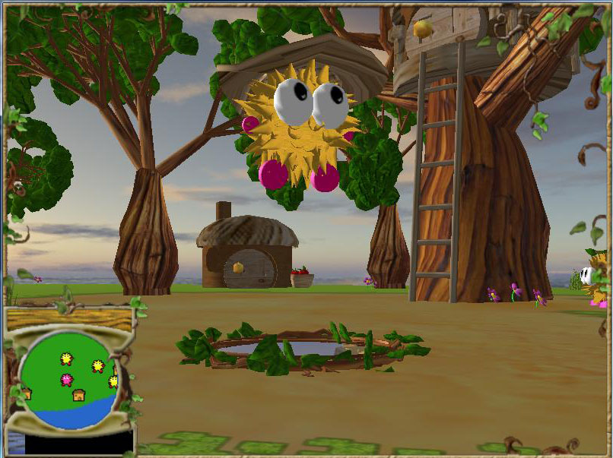
https://www.youtube.com/watch?v=mWmSGH_ulGw#t=187

Slide 46
Recursive
Ray Tracing

Slide 47

A Little Bit of Slope
John Ousterhout

